Slide 1

KONGUNADU COLLEGE OF ENGINEERING & TECHNOLOGY (AUTONOMOUS) NAMAKKAL- TRICHY MAIN ROAD, THOTTIAM DEPARTMENT OF ARTIFICIAL INTELLIGENCE AND DATA SCIENCE
PROJECT GUIDE:
Mrs.P.G .Gayathri(AP/AD)
PROJECT TEAM:
G.David William (621321243004)
T.Sutharsan (621321243053)
N.Vigneshwaran (621321243059)
BATCH NO:03

Slide 2
Sales Forecasting using Machine Learning

Slide 3
ABSTRACT
Sales forecasting is a vital component of corporate planning and management, allowing firms to make educated decisions and allocate resources more efficiently. This study investigates the use of logistic regression, a statistical modelling tool, in the context of sales forecasting. Logistic regression, which was formerly used for binary classification, has been extended to predict sales results by taking into account a variety of characteristics that impact purchase choices. The study makes use of past sales data and takes into account significant factors such as marketing expenses, economic indicators, and seasonality. A thorough investigation is performed to determine the major variables that influence sales and a logistic regression model is created to quantify their associations. The model's performance is measured using measures like as accuracy, precision, and recall. The project has a desktop application with the store managing capabilities to analyze and handle the stocks with count and expiry notification to give the alert of the stocks are invalid to the sales to increase the sales of the stores.

Slide 4
INTRODUCTION
In todays modern world business plays major role that helps to the person who enters into new in the field of business.
The basic of the business follows ‘R’ rule which the product should get into action at right time, place, price, person.
Forecasting makes the business to higher contribution in the nation’s economy that makes the stocks of the investors get to the value better than the later value of stocks.
The forecasting can be done by using the various machine learning algorithms which can predict the sales and stock values

Slide 5
LITERATURE SURVEY
Muhammad Adnan Khan, Shazia Saqib, Tahir Alyas, Anees Ur Rehman, Yousaf Saeed, Asim Zeb, Mahdi Zareei, Ehab Mahmoud Mohamed, IEEE Access.
Title: Effective Demand Forecasting Model Using Business Intelligence Empowered With Machine Learning.
Author and Year : Muhammad Adnan Khan, 2020.
Techniques: Machine Learning.

Slide 6
Yiyang Niu, 2020 International Conference on Big Data & Artificial Intelligence & Software Engineering (ICBASE)
Title: Walmart Sales Forecasting using XGBoost algorithm and Feature engineering.
Author and Year: Yiyang Niu, 2021.
Techniques: Machine Learning.

Slide 7
Bineet Kumar Jha, Shilpa Pande, 2021 5th International Conference on Computing Methodologies and Communication (ICCMC).
Title: Time Series Forecasting Model for Supermarket Sales using FB-Prophet.
Author and Year: Bineet Kumar Jha, Shilpa Pande, 2021
Techniques: The additive model, the Autoregressive integrated moving average (ARIMA) model, FB Prophet model.

Slide 8
EXISTING SYSTEM
Experts analyze: Expert opinions, market surveys, and qualitative assessments play a role in sales forecasting.
Statistical models: Traditional statistical models, such as time series analysis and regression analysis, are commonly used for sales forecasting.
Microsoft tools: Many organizations still use spreadsheet tools like Microsoft Excel for basic sales forecasting.

Slide 9
Disadvantages
Predicted irrelevant opinion.
Could not able to analyze large volume of data.
This should takes lots of time.
It does not notify about the stocks that are stored in the warehouse or the market.

Slide 10
PROPOSED SYSTEM
It involves leveraging advanced technologies, data analytics, and machine learning algorithms to enhance the accuracy, efficiency, and adaptability of the forecasting process.
Contains various types of algorithms for each specific models while predicting the sales performance.

Slide 11
Advantages
Stocks are handled easily by the marketer.
Notification is send to the marketer when the stocks are in low limit.
Individual products sales can be predicted.

Slide 12
Hardware Requirements
Processor : Dual core processor 2.6.0 GHZ
RAM : 1GB
Hard disk : 160 GB
Compact Disk : 650 Mb
Keyboard : Standard keyboard
Monitor : 15 inch color monitor

Slide 13
Software Requirements
Operating system : Windows OS.
Front End : HTML and CSS.
Back End : Python.

Slide 14
Modules Spilt-up
Data Collection and Integration Module.
Data Preprocessing.
Feature Engineering.
Machine Learning Algorithm.
User Interface (UI) Module.

Slide 15
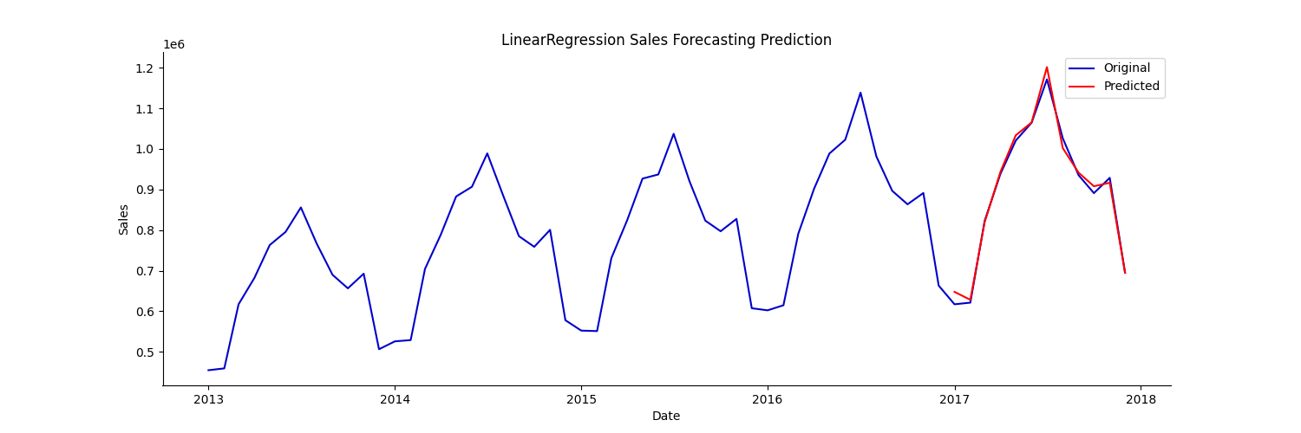
Prediction analysis by various algorithms
Using Linear Regression:

Slide 16
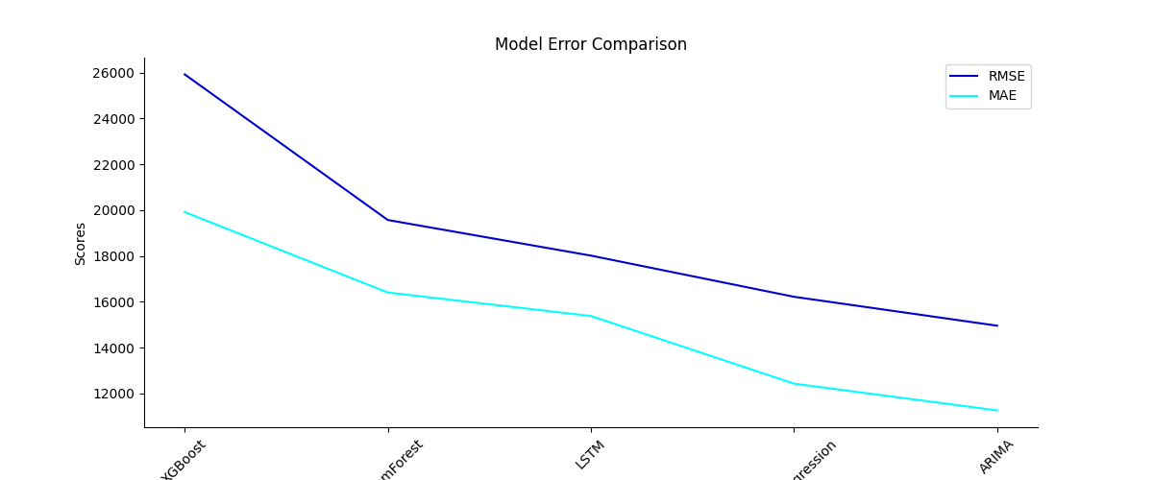
Comparing all models:

Slide 17
Conclusion
The users have multiple angle of ideas and predictions based on their product sales according to the dataset.
By using the different algorithms there are open level of decision making for the business purpose.
Business analytics by the various machine learning algorithm such as linear regression, Adaboost, Xgboost are more efficient to the business about sales forecasting.
Higher probability to uplift the business.

Slide 18
References
[1] Bineet Kumar Jha, Shilpa Pande, 2021 5th International Conference on Computing Methodologies and Communication (ICCMC).
[2] Yiyang Niu, 2020 International Conference on Big Data & Artificial Intelligence & Software Engineering (ICBASE)
[3] Muhammad Adnan Khan, Shazia Saqib, Tahir Alyas, Anees Ur Rehman, Yousaf Saeed, Asim Zeb, Mahdi Zareei, Ehab Mahmoud Mohamed, IEEE Access.
[4] Online Sales Prediction: An Analysis With Dependency SCOR-Topic Sentiment Model Lijuan Huang, Zixin Dou, Yongjun Hu, Raoyi Huang. IEEE Access.
[5] Forecasting Promotional Sales Within the Neighbourhood Carlos Aguilar-Palacios, Sergio Muñoz-Romero, José Luis Rojo-Álvarez. IEEE Access.

